Slide 1
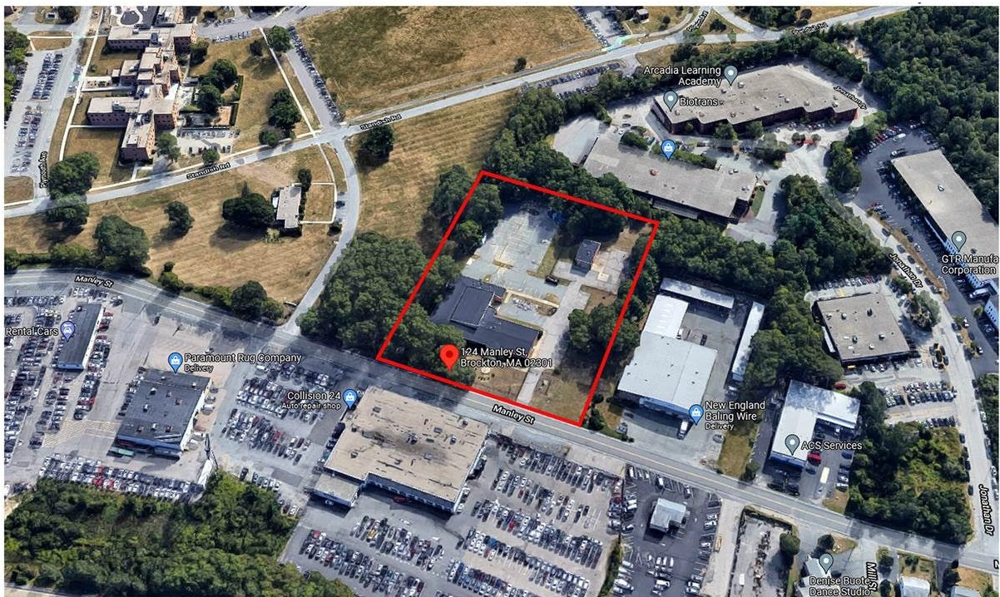
Proposal for
Manley Street Housing
124 Manley Street, Brockton, MA
Proposal by
PTEH
10) tt""-'<t 1',-U'1
IMCllllO
Father Bill's & MainSpring
430 Belmont St., Brockton, MA 02301
PLACETAILOR ELTON HAMPTON DESIGN

Slide 2
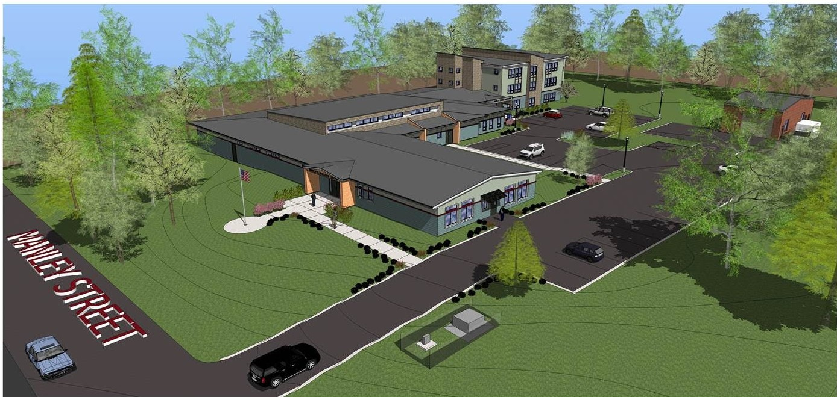
Proposal for
Manley Street Housing
124 Manley Street, Brockton, MA
w PLACETAILOR ELTON HAMPTONDESIGN
Proposal by
Father Bill's & MainSpring
430 Belmont St., Brockton, MA 02301
PTEH
=,....,..,...,_, ,.,'°
October 2021

Slide 3
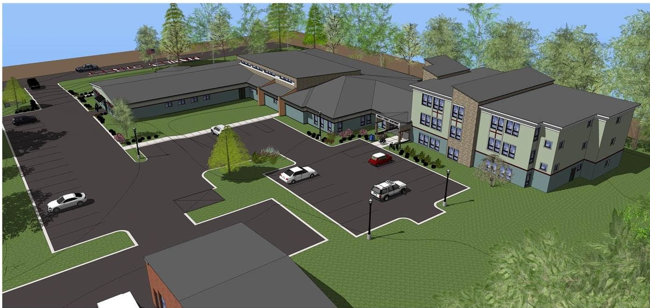
Manley Street Housing
124 Manley Street, Brockton, MA
Proposal for
_{w} PTEH ,........,........... ,.
PLACETAILOR ELTON HAMPTON DESIGN
Proposal by
Father Bill's & MainSpring
430 Belmont St., Brockton, MA 02301

Slide 4
Manley Street Housing
124 Manley Street, Brockton, MA
Proposal for
a_, -
PTEH
PLACETAILOR ELTON HAMPTON DESIGN
Proposal by
Father Bill's & MainSpring
430 Belmont St., Brockton. MA 02301
October 2021

Slide 5
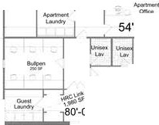
Proposal for
Manley Street Housing
124 Manley Street, Brockton, MA
3 STORY APARTMENT BUILDING
WITH
ICJ., -
•
IL]_ l -_--,
1 " [
•
I 1 I---J[....------,.I1
32 STUDIO
c J '1 EFFICIENCY
UNITS
APARTMENT BUILDING
2nd FLOOR PLAN
(3rd Sim)
r :f
'
t l
•
,_₋....
I
I
_{t} ]
I
•
,_u,;,
APARTMENT BUILDING
1st FLOOR PLAN
J
~•
,
t
1-i::--,]i--;-----1c
•
c:-
...._(--1
-- J
•
e w
- --
54'-0"
I
0
'
•
I
0
<")
-iwh 7
..._. l-J 1
c::;-
<O
-
HRC OffiIces
,...
.
'
N
°.,".".'
•
6'-6I"
I
I
o·
-
• •
.°.".".
e
••
.-....,
.,.-u
I ₋.L
NEWCO.NSTRVCtlON ♦
........
...
EXISTING REHAB +
Kitchen
""""'
I
'
I
l
•
-
.....,
◄
I
I
- +--
'
=1
'
L
' '
r.
Oini1)91
Activily Room
T-.&Q«l(li!O
HRC Lawn
-
HRC I
₋ I
...
0
,
st'
Men's Dorm
►
►
Rec,ea!ion
- ₋
⁻ r: *
►I
-
f)riV.)!O
"'"""....
Mech/Ulilities
°"""
►
Men's Donn
◄
PIW4'1tu
ltlt,Nill'WS
-
Patient ◄
Care
Men
-
rr
•
.._" "L _, .iL
Recep1ion
•
- _J
NurseStallon
(_",)
N
II)
_-=-...,_w_ome n
-.:...-o_m,en·s OJ
Security
•
Respite Rm
Adaptive Reuse•of Army Reserve Building To:
96+32 BED HOMELESS
RESOURCE CENTER
MainEn
•
J
I
r--...
Proposal by
Father Bill's & MainSpring
430 Belmont St., Brockton, MA 02301
b
l•o
Men'$0orm
•
RecRoom:
II(
Section Through Men's Dorm
PTEH
10::, TU<RACE: $TRl1ET, ROXIIVRY. MA021)0
October 2021
PLACETAILOR ELTON HAMPTON DESIGN

